Slide 1


Spring boot - ELK
Mr. Vijay Kumar
Software Architect
16+ Years of Experience
Email: vijumca@gmail.com

Slide 2

Spring boot - ELK
Why Micro Services
Monolith vs Micro Services
Why ELK?
Overview on Distributed Logging
Overview on Elastic Search
Overview on Kibana
Overview on Logstash
Splunk vs ELK
Hands on Spring Boot with ELK
Installation of ELK
Spring boot logs on ELK DashBoard

Slide 3
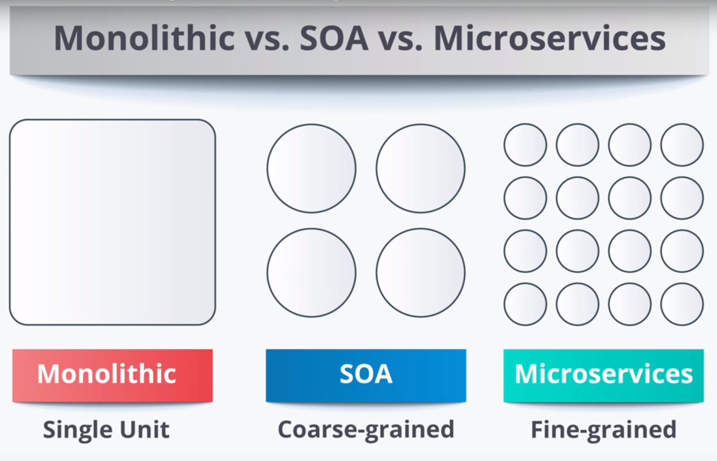

Slide 4
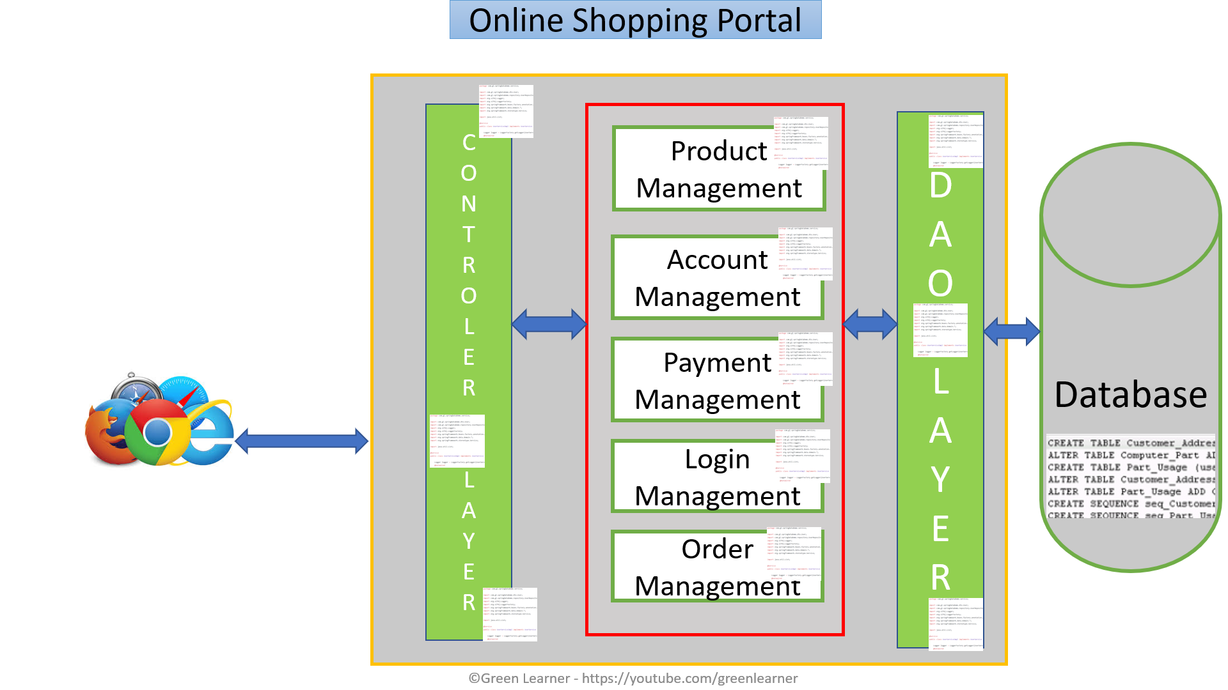
Monolith – positive aspects
Simple testing
Quick deployment
Easy to develop

Slide 5
Monolith – positive aspects
Easy to scale by having multiple copy of same application(horizontal scaling)
Less technicality
Better for small scale apps

Slide 6
By the time company grows
so the application

Slide 7
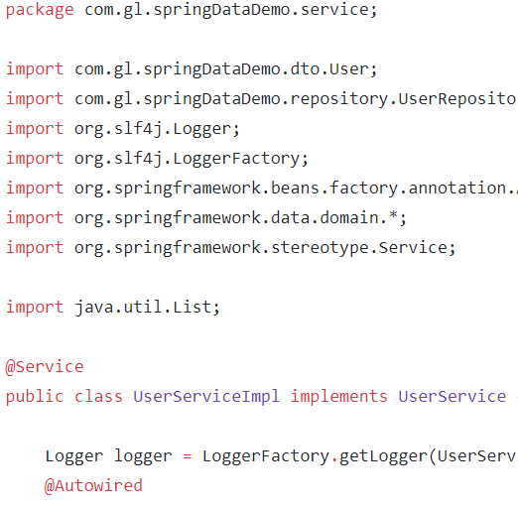
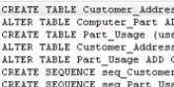



Online Shopping Portal
C
O
N
T
R
O
L
E
R
L
A
Y
E
R
D
A
O
L
A
Y
E
R
Product Management
Database
Account Management
Payment Management
Login Management
Order Management

Slide 8
Monolith – Challenges
Limitation in size
Complexity grows with time
Long time to release new features
Even small change in one module needs redeployment of whole application
More time to send the fix for production bug

Slide 9
Monolith – Challenges
High Dependency on few human resources
Hiring new team and making them understand whole application is tough
Stuck in one technology
Single point failure

Slide 10
Monolith – Challenges
Continuous deployment is difficult
Difficult to scale when we have large code base
High coupling between modules
Reliability and availability problem

Slide 11


Slide 12
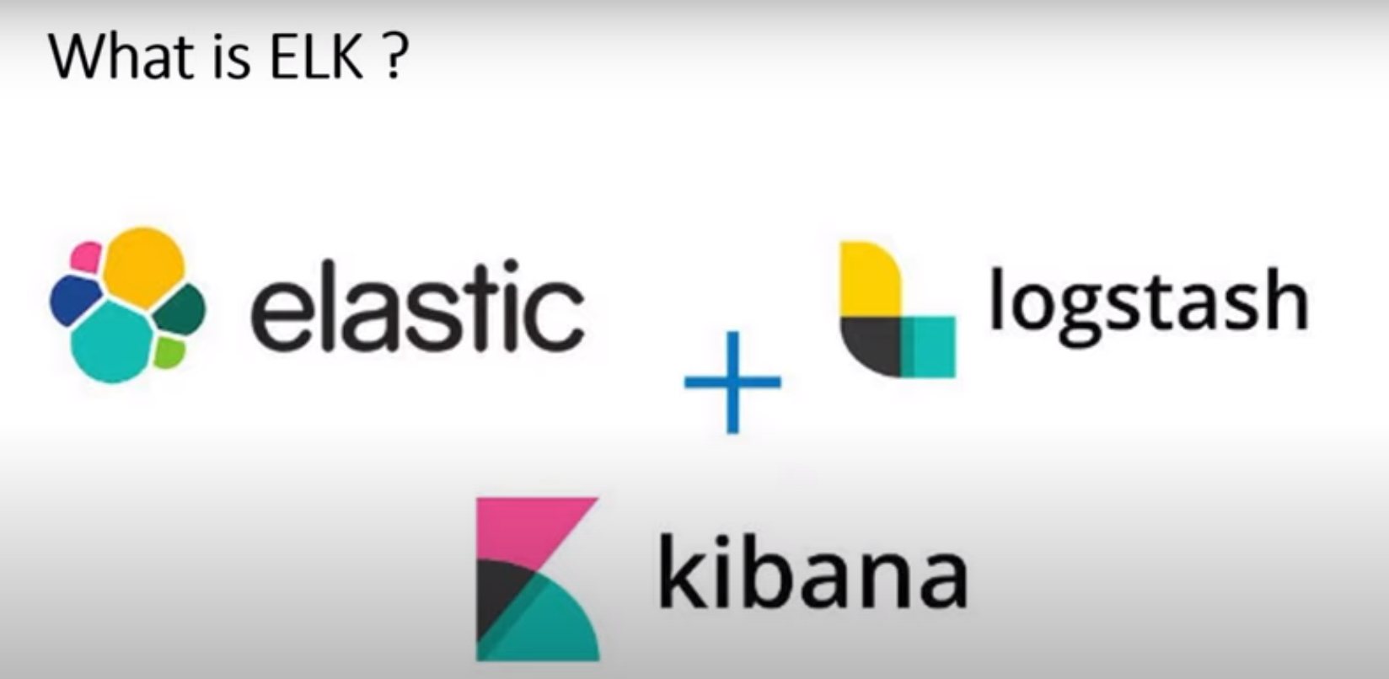

Slide 13
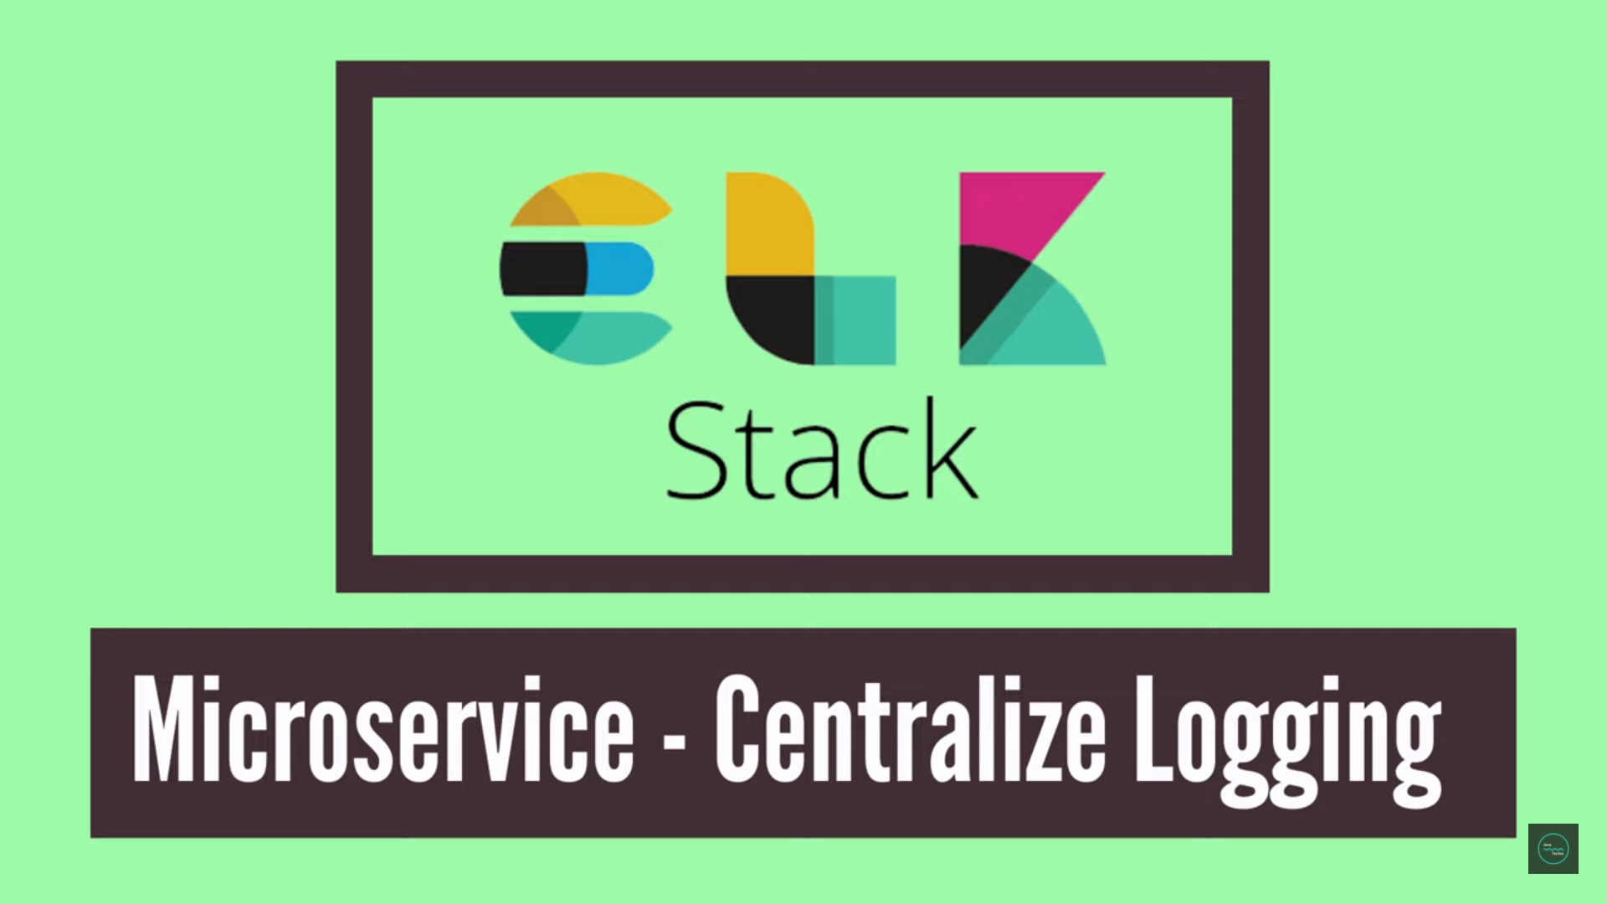

Spring boot - ELK

Slide 14
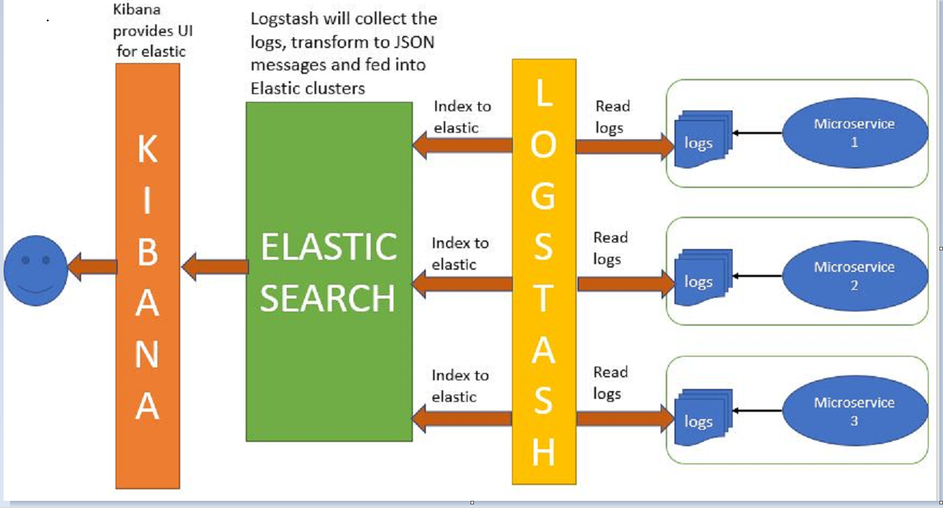
Spring boot - ELK

Slide 15
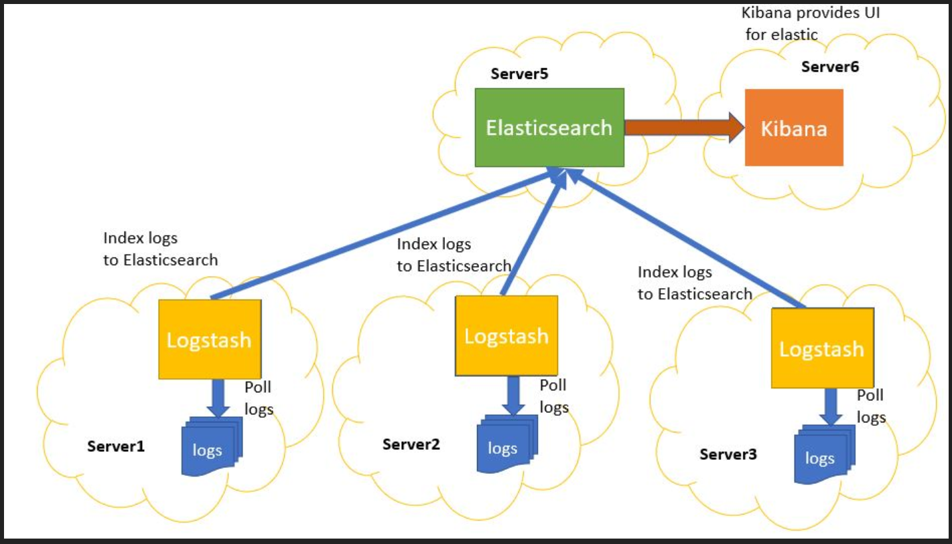

Slide 16
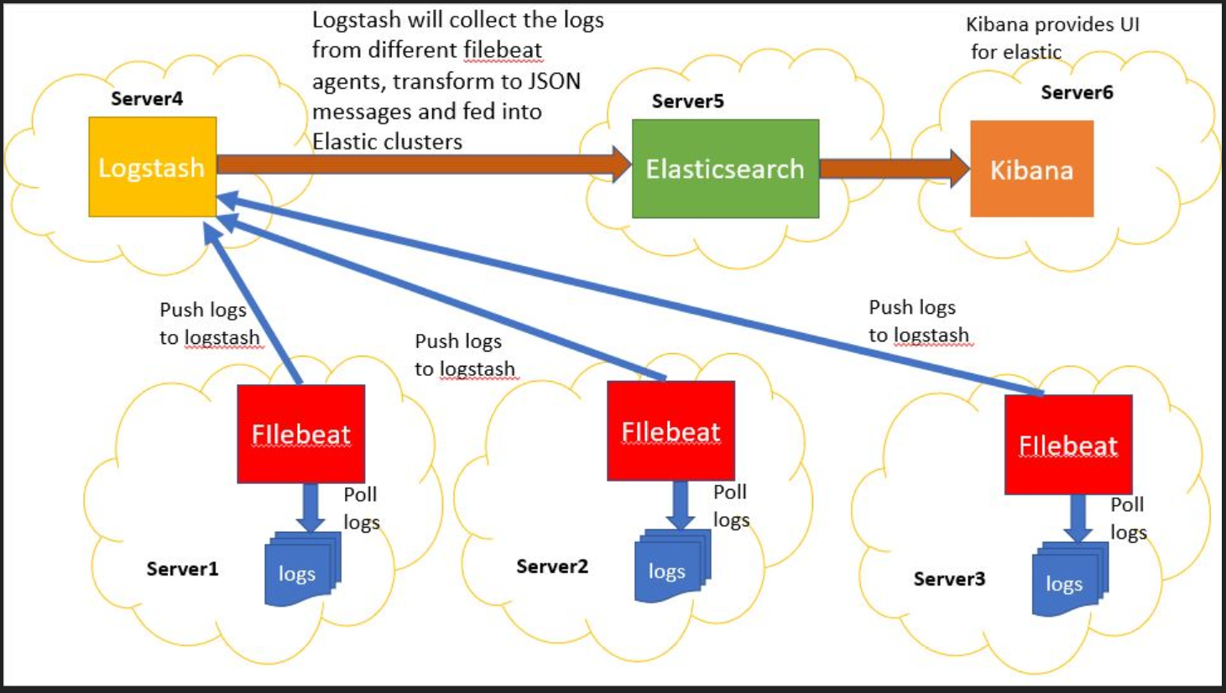

Slide 17
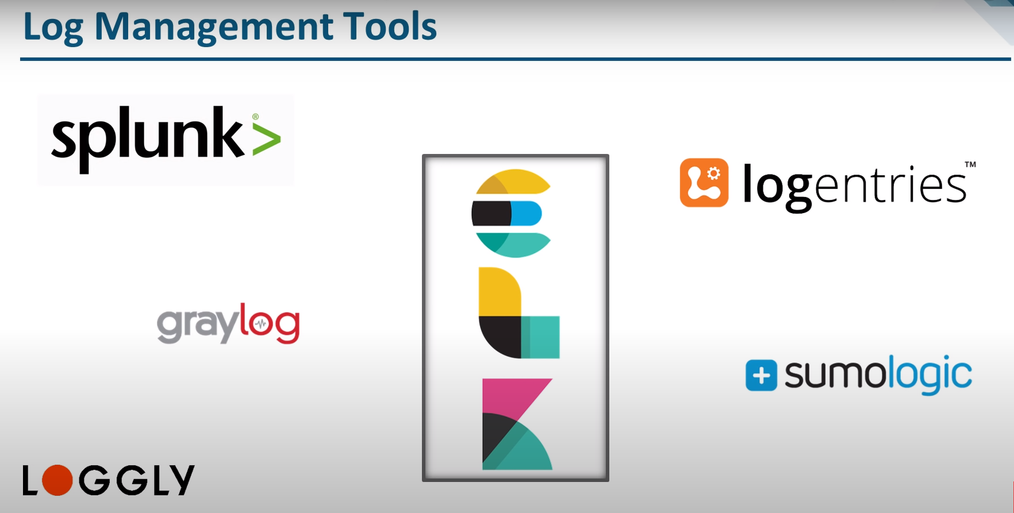
Spring boot - ELK

Slide 18
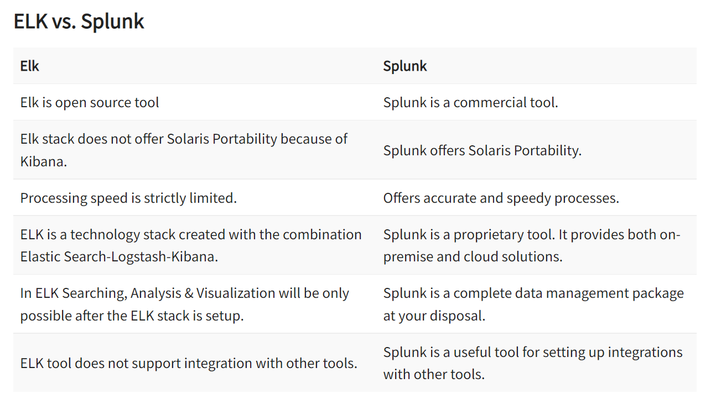
Spring boot - ELK

Slide 19
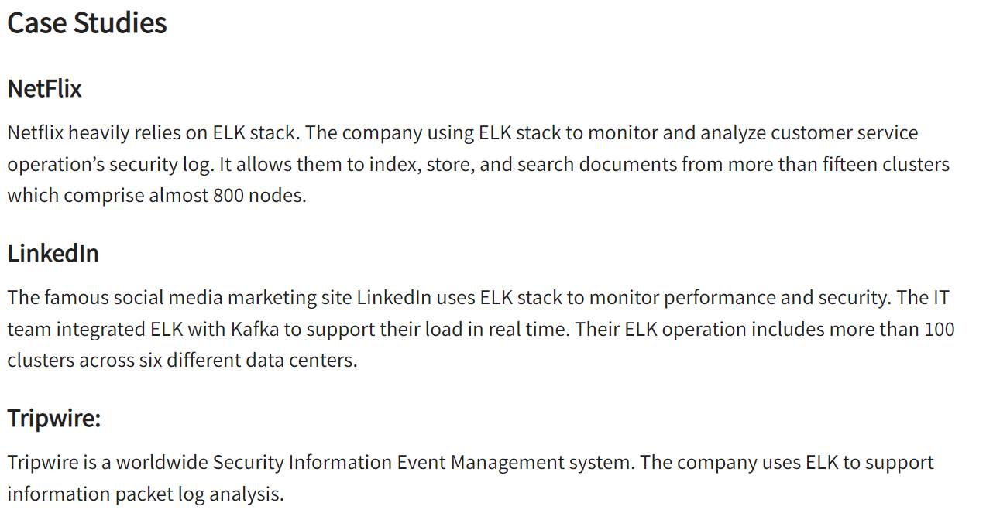
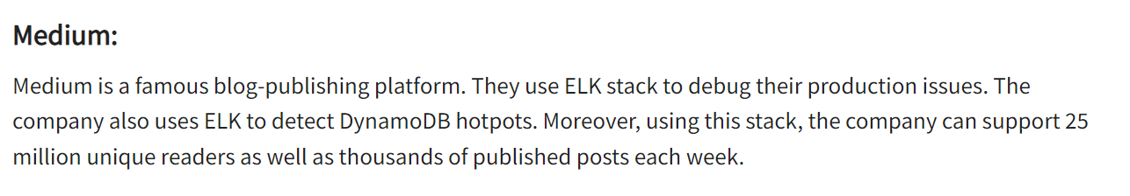
Spring boot - ELK

Slide 20
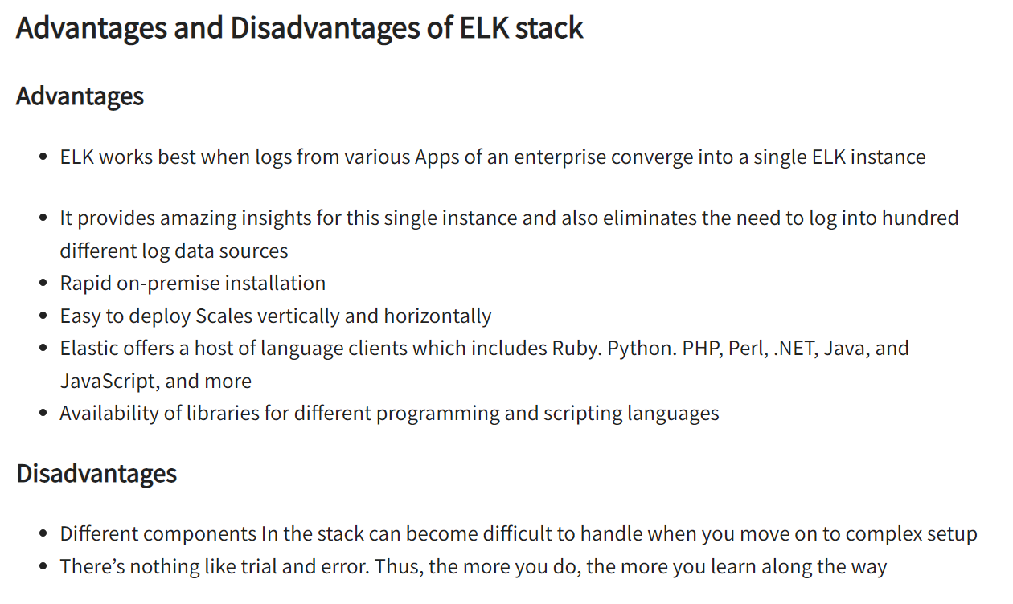
Spring boot - ELK

Slide 21
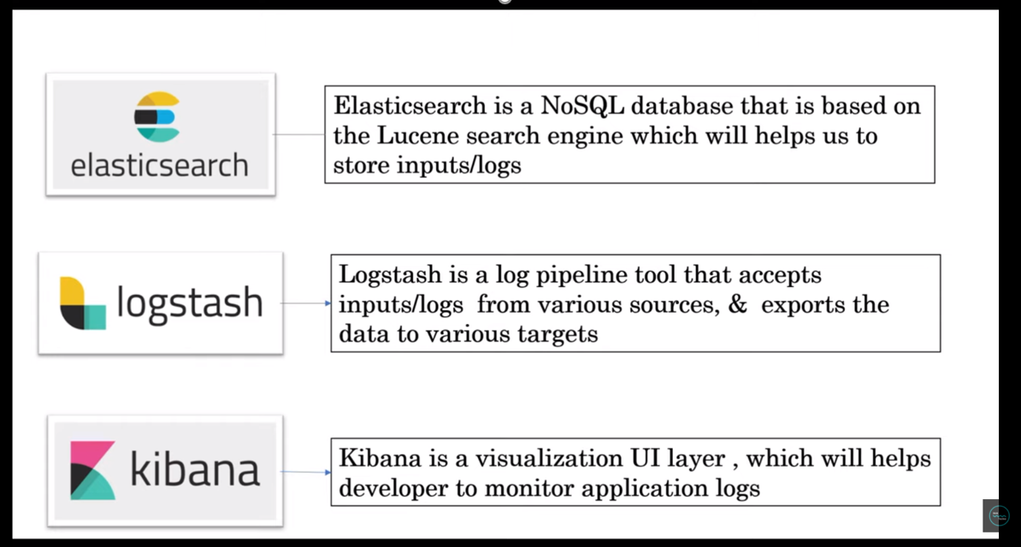
Spring boot - ELK

Slide 22
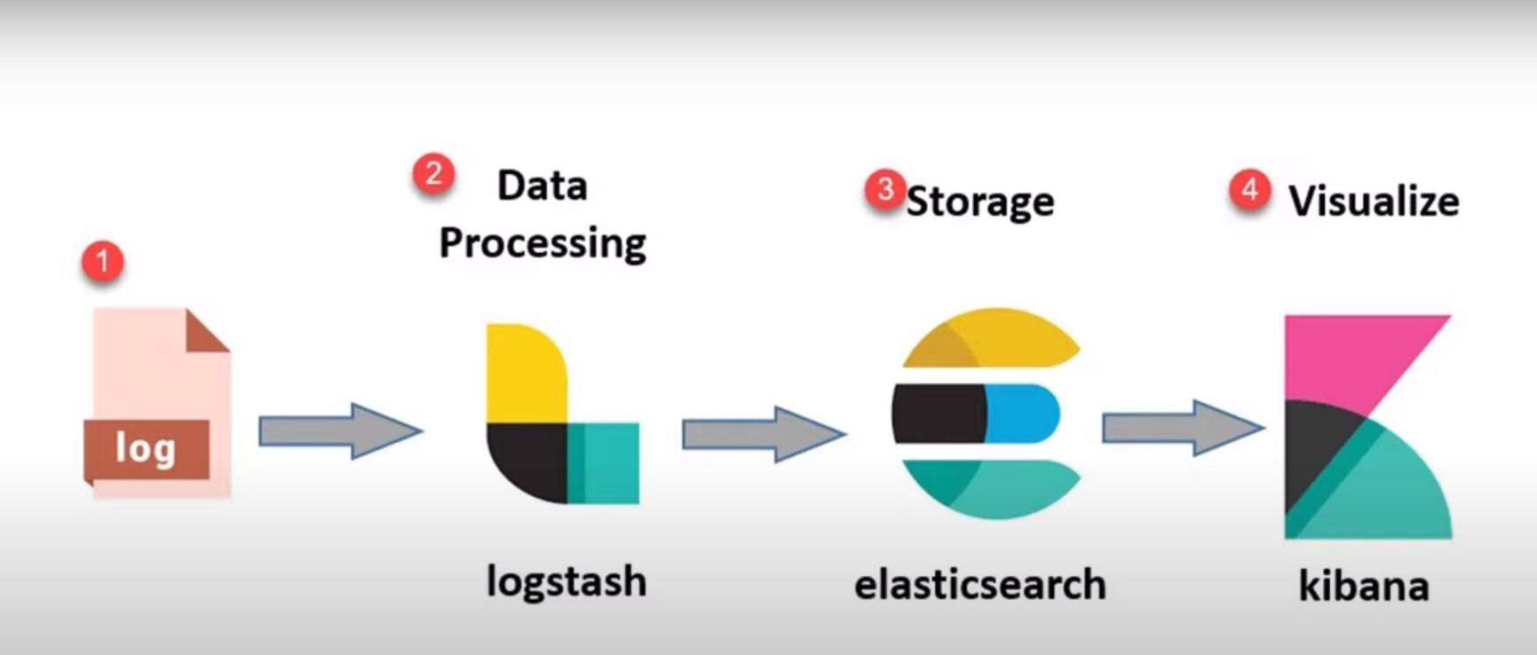
Spring boot - ELK

Slide 23
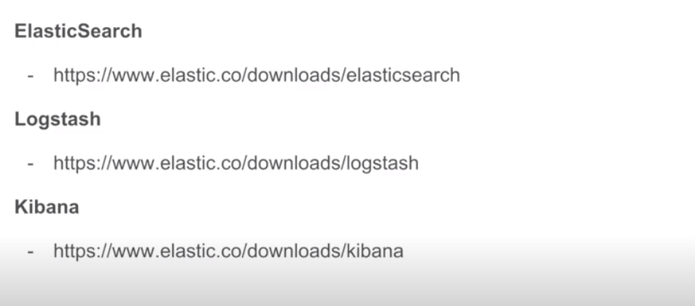

Slide 24
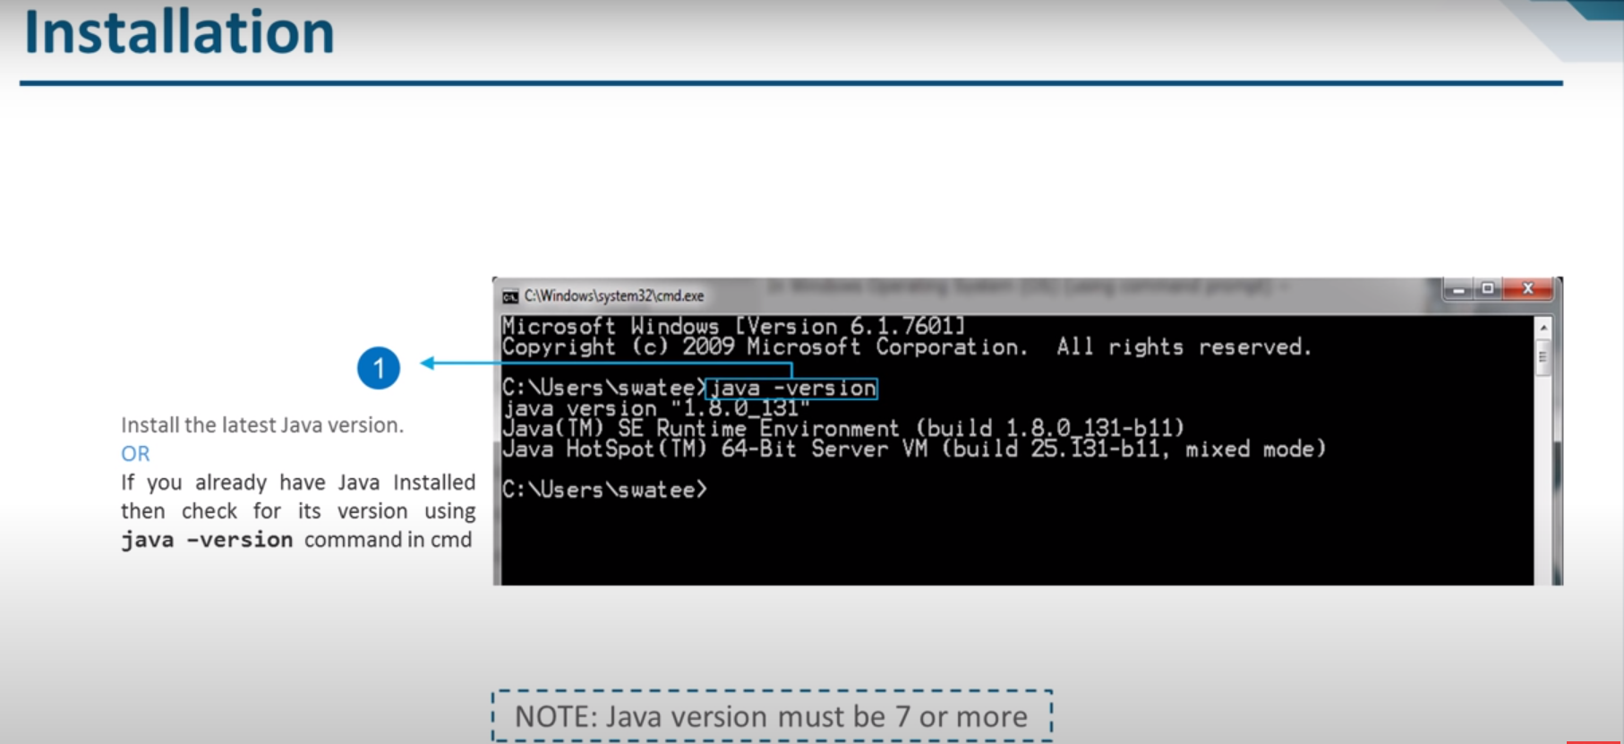

Slide 25
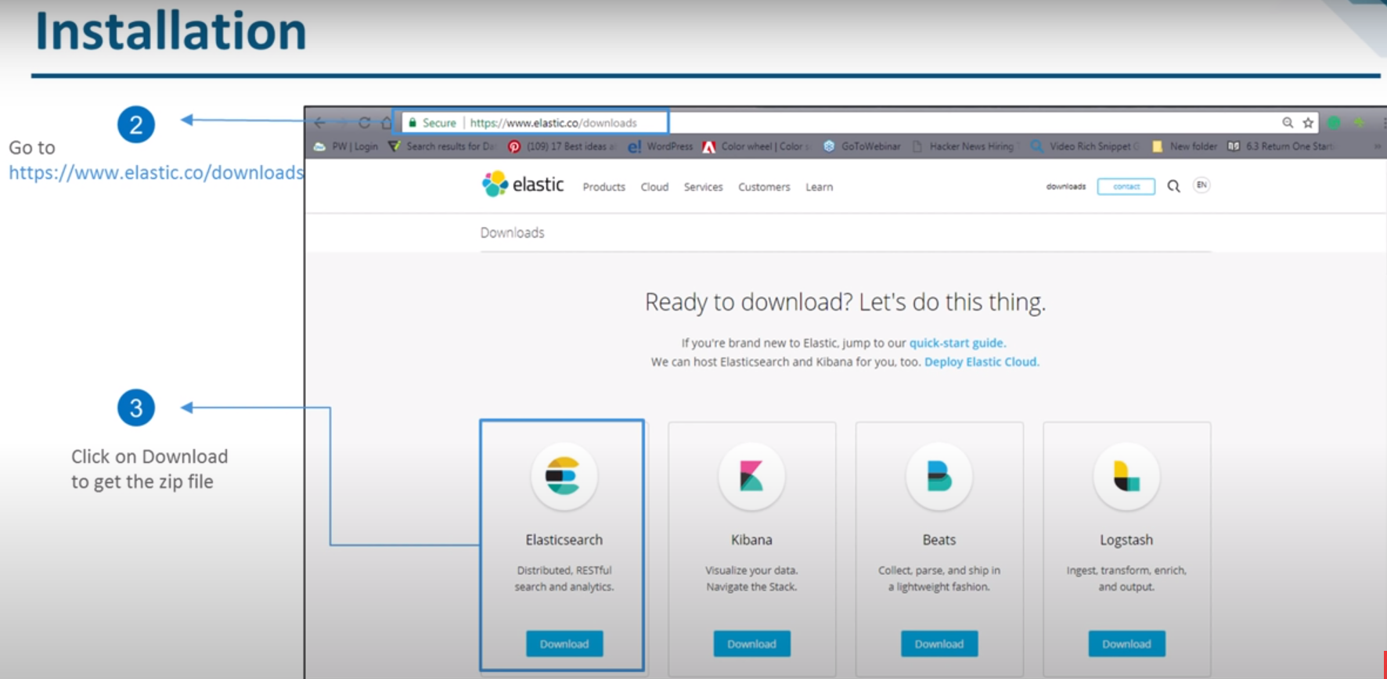

Slide 26
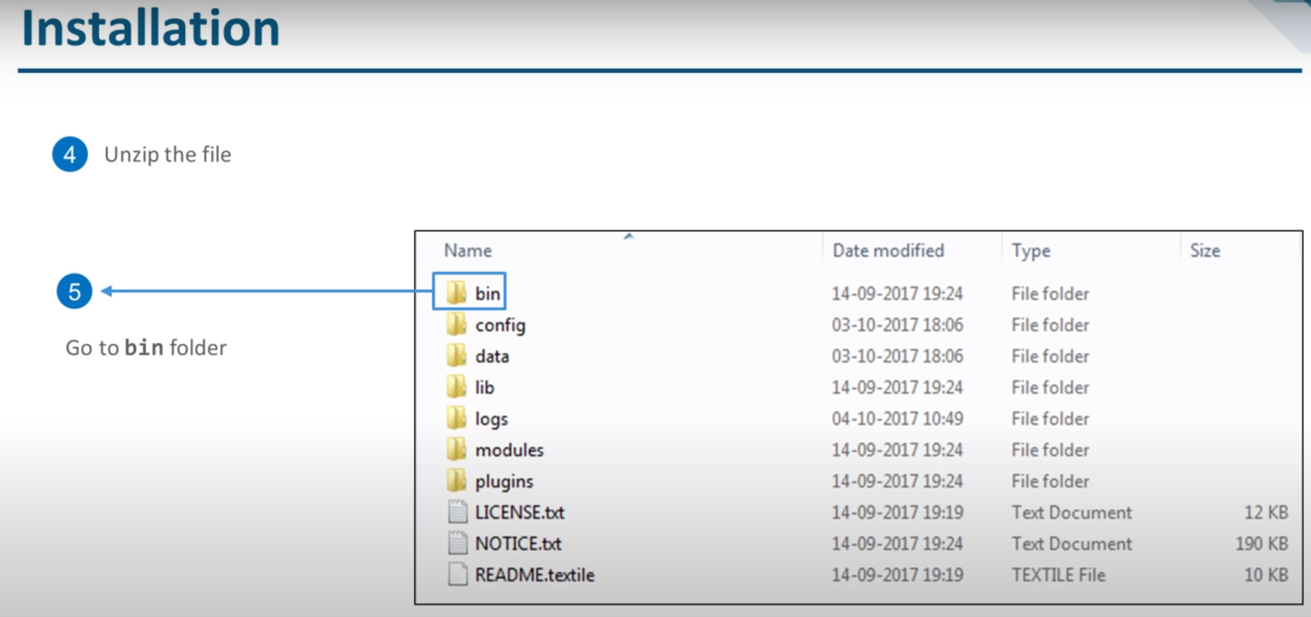

Slide 27
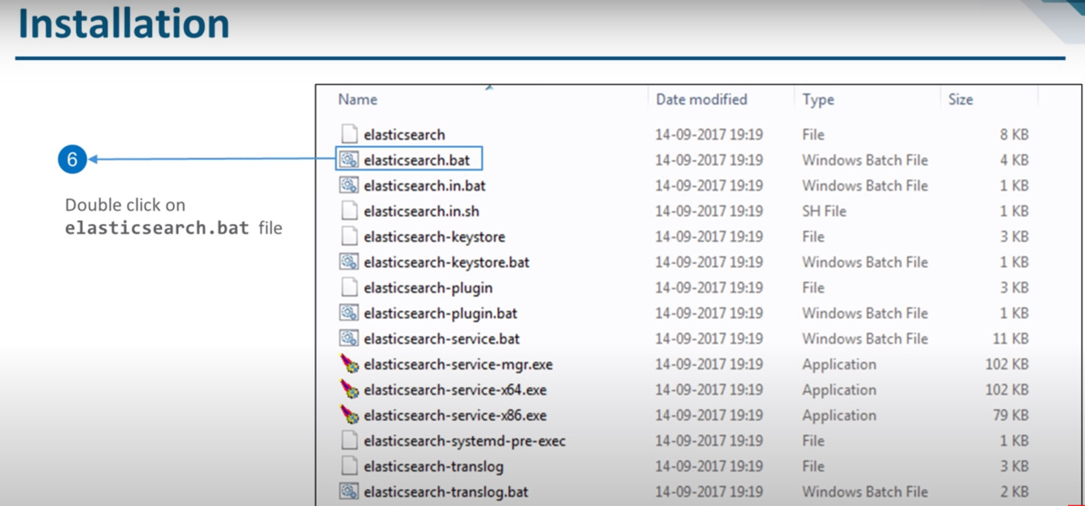

Slide 28
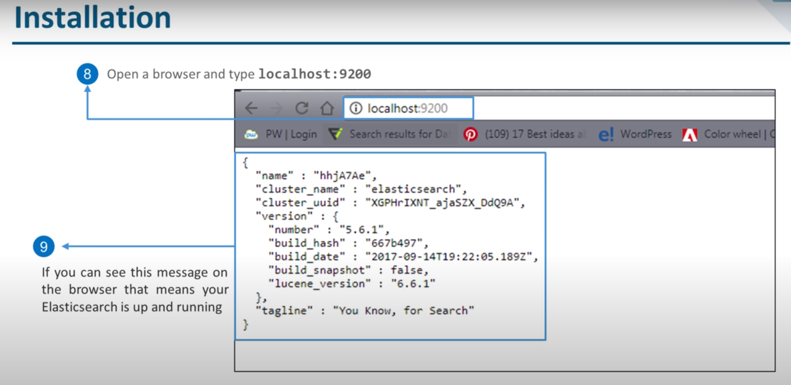

Slide 29
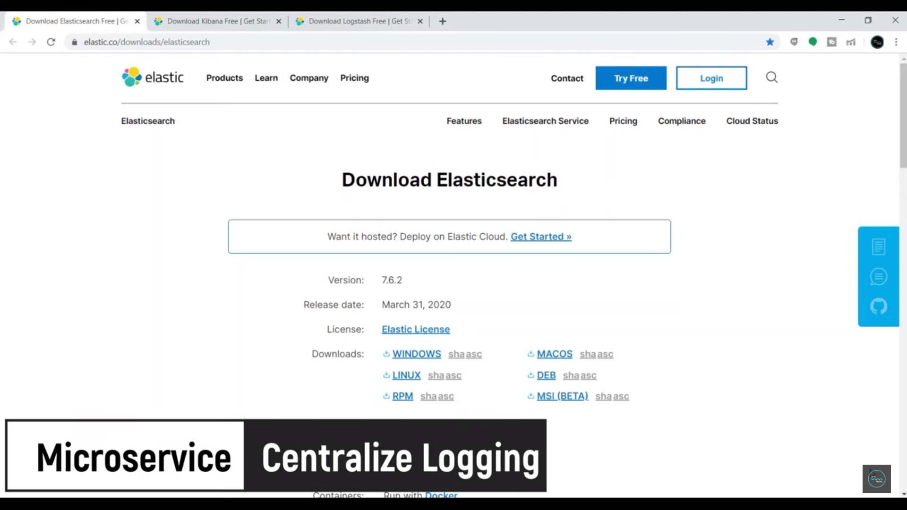

Slide 30
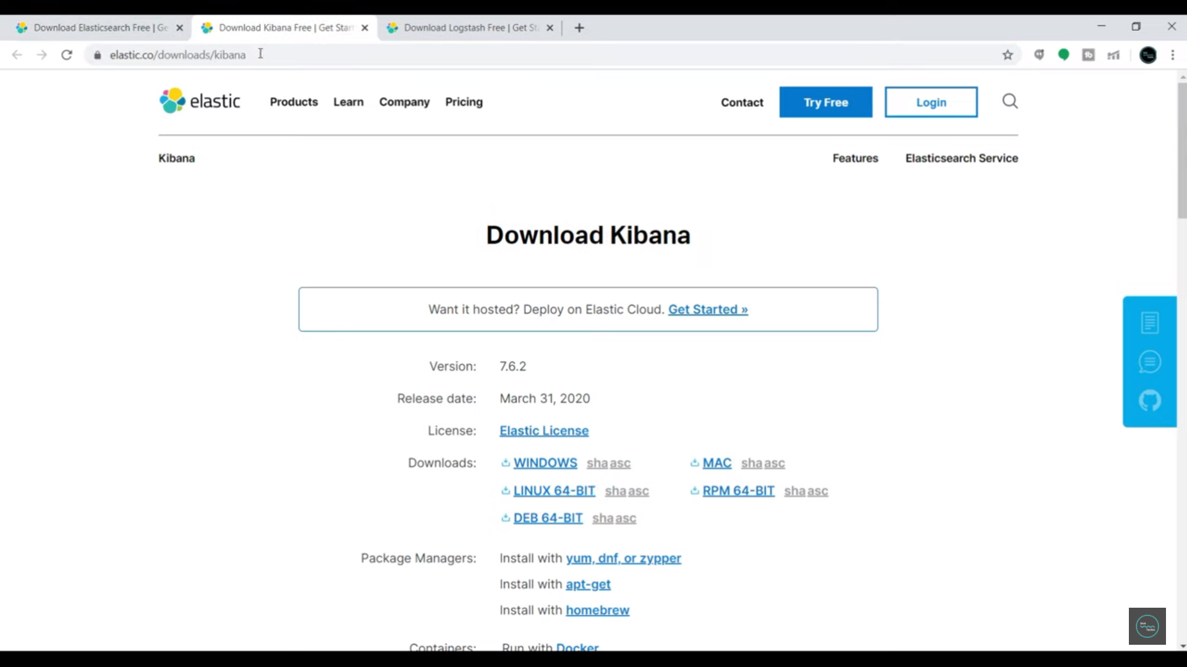


Slide 31
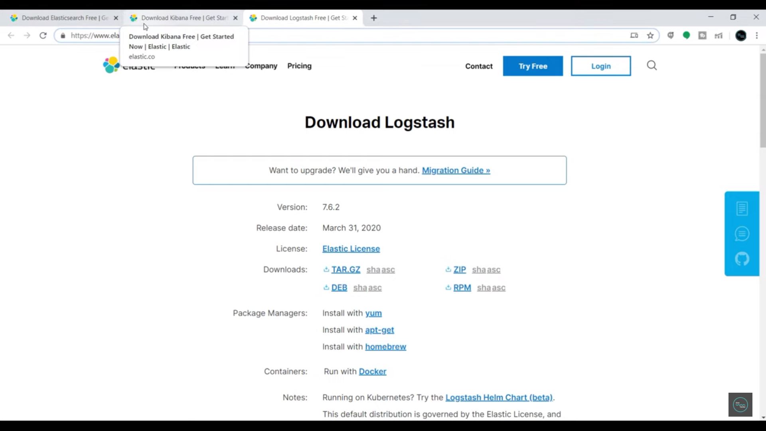

Slide 32
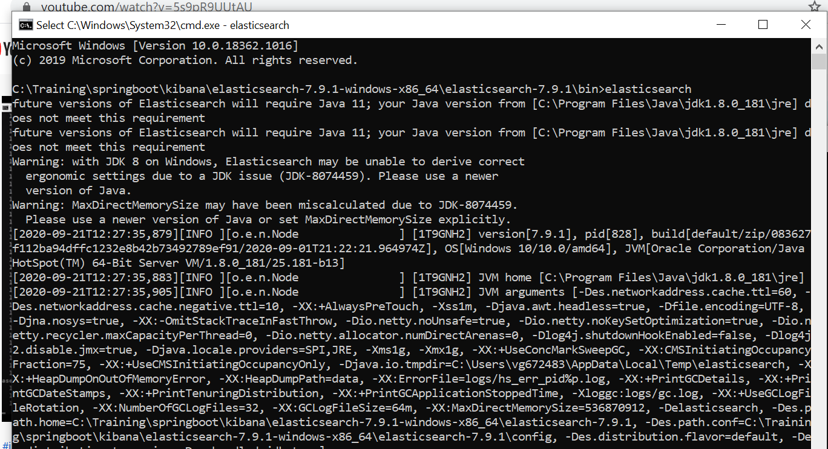
Elastic Search Configuration

Slide 33
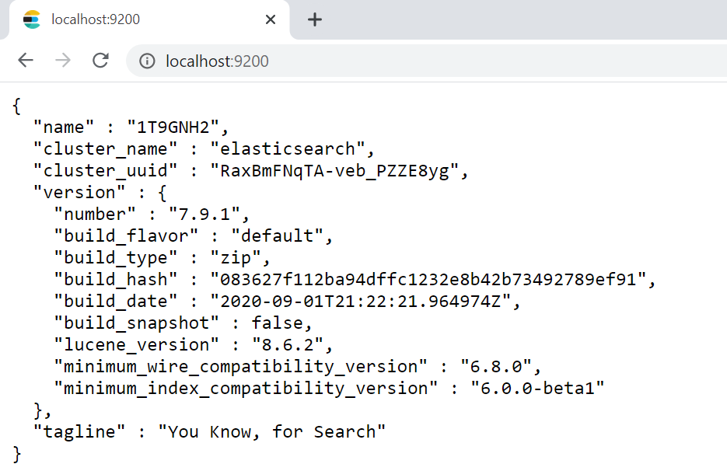
Elastic Search Configuration

Slide 34
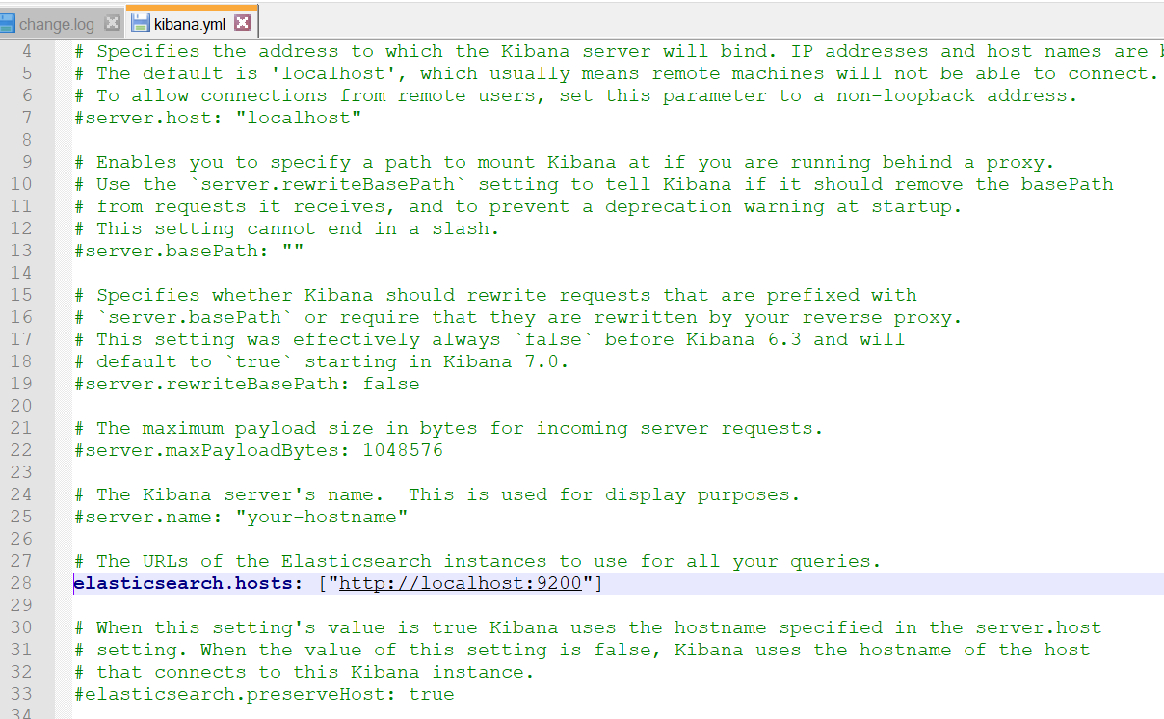
Kibana Configuration

Slide 35
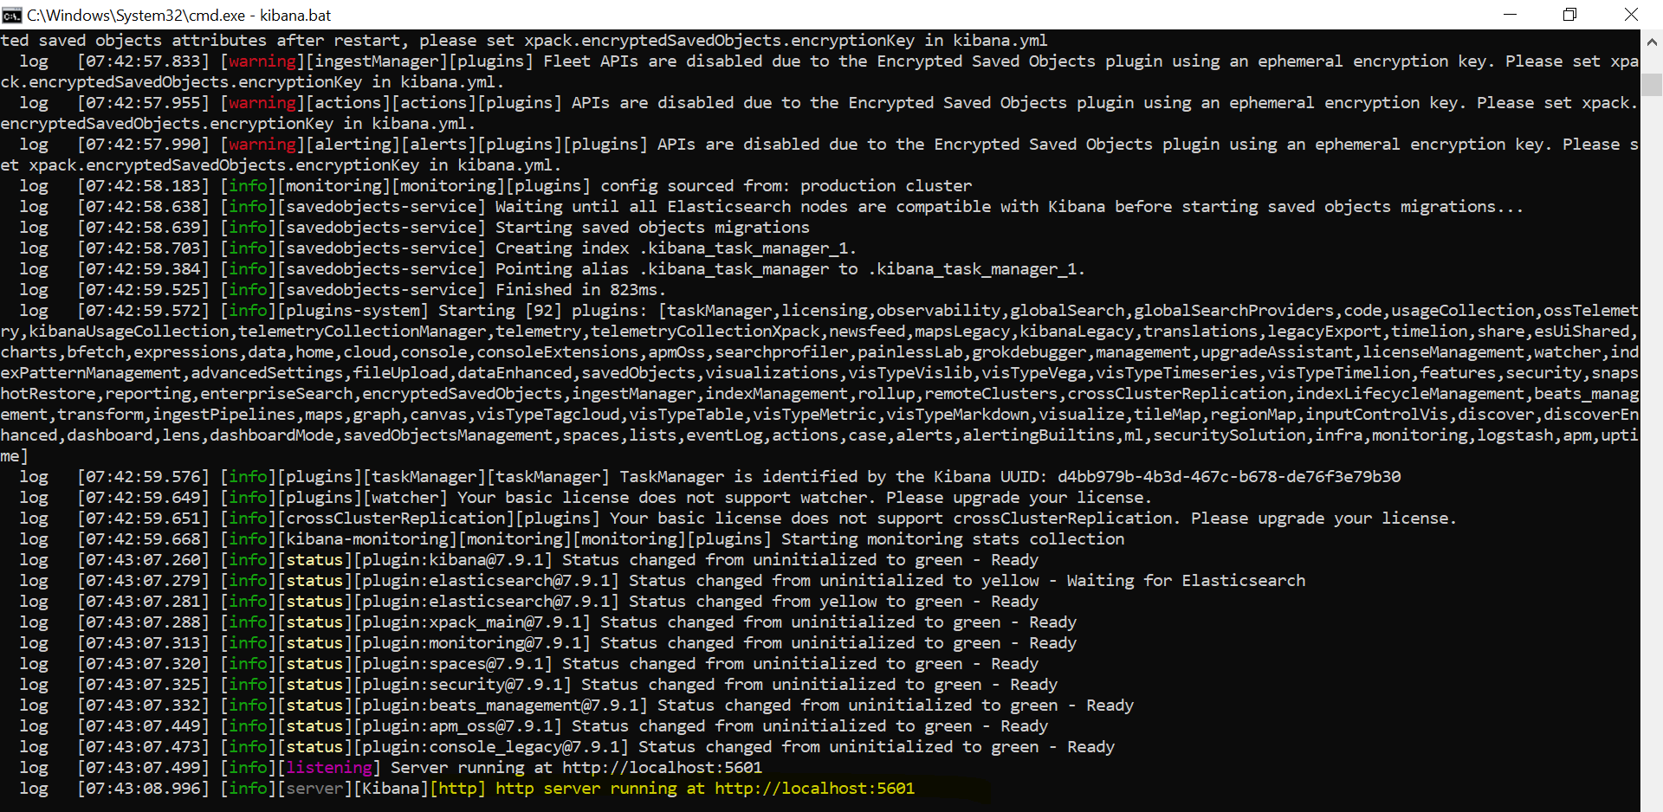
Kibana Execution

Slide 36
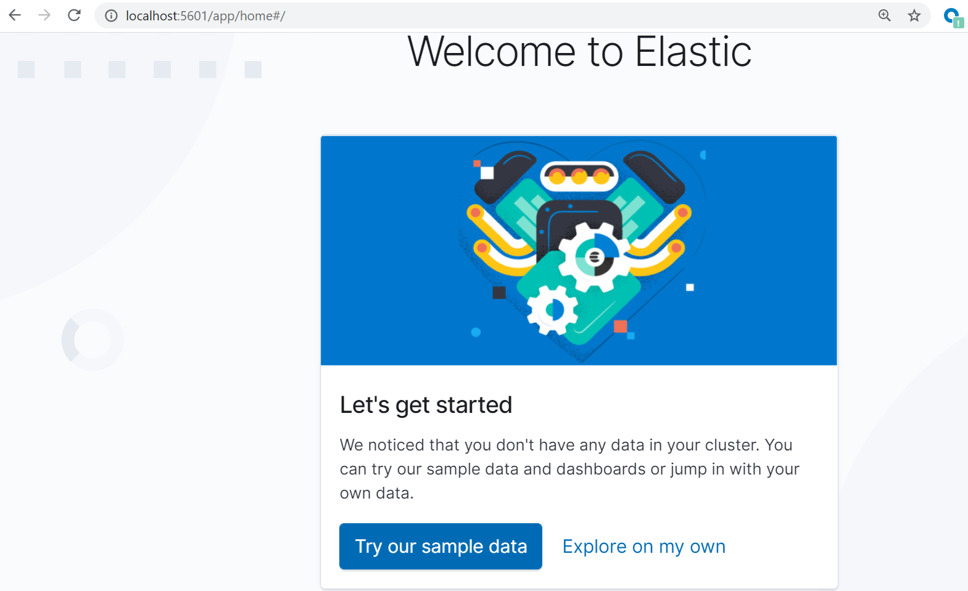

Slide 37
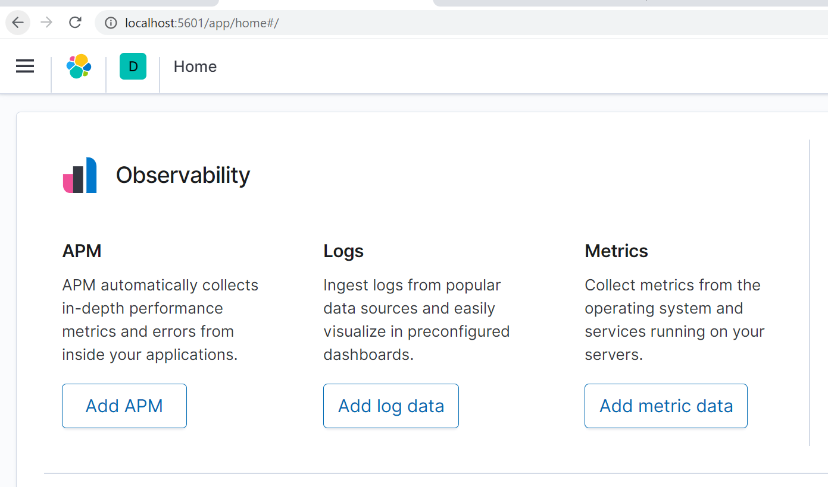
Spring Boot Application

Slide 38
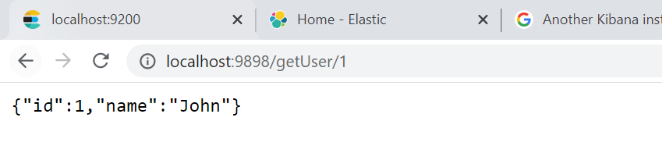
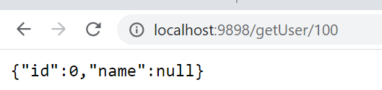
Spring Boot Application

Slide 39
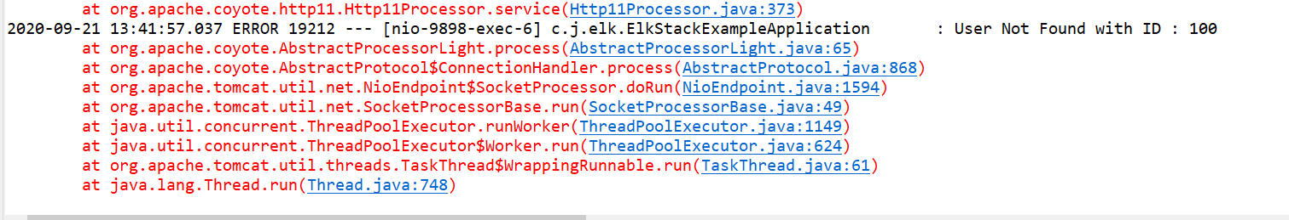
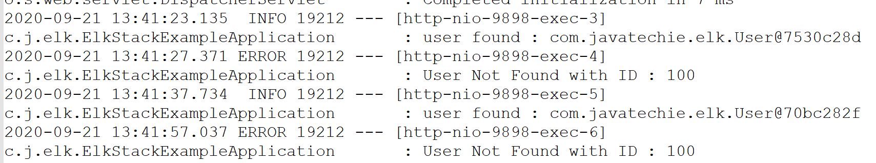
Spring Boot Exception - Application

Slide 40
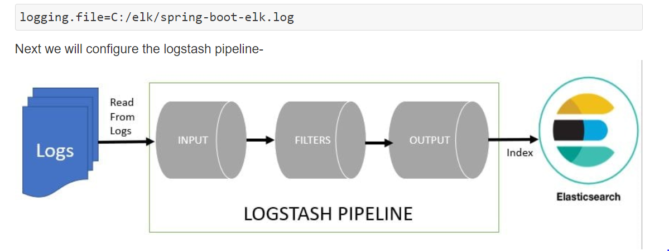

Slide 41
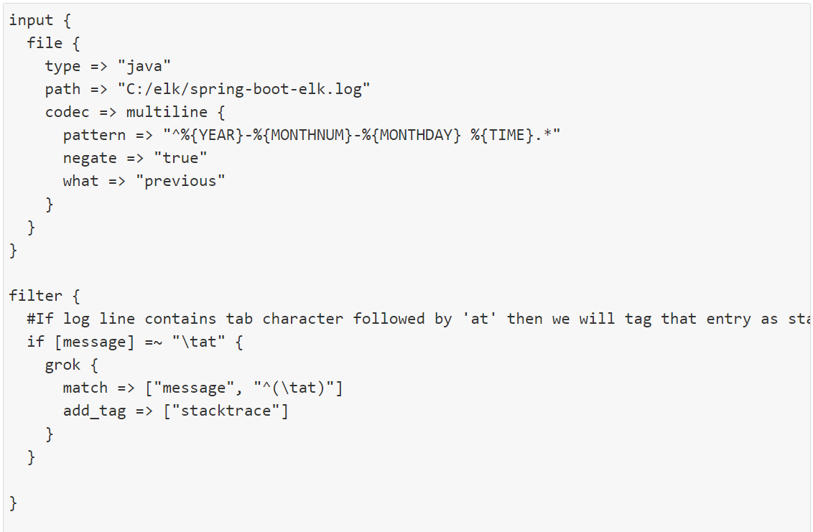
LogStash Configuration

Slide 42
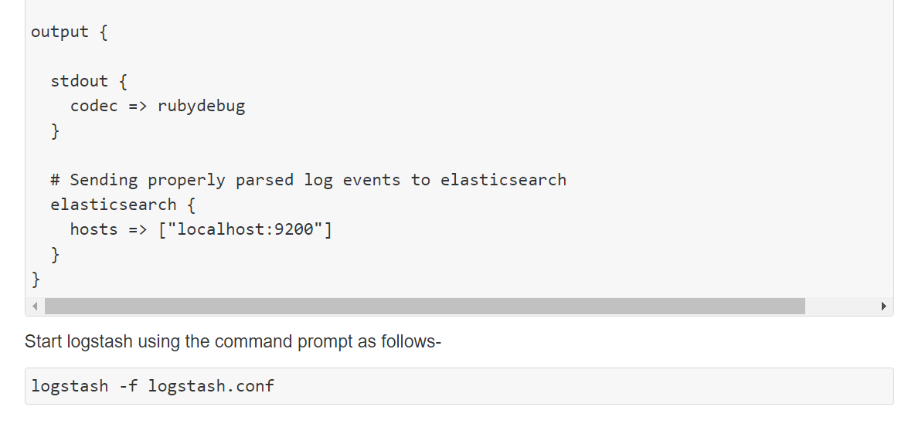
LogStash Configuration

Slide 43
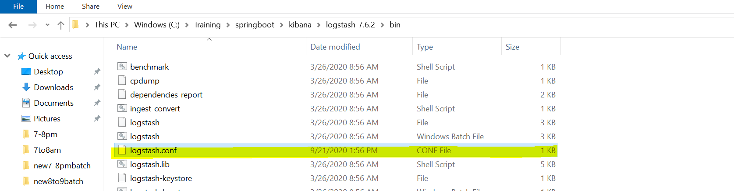
Kibana Installation Path

Slide 44
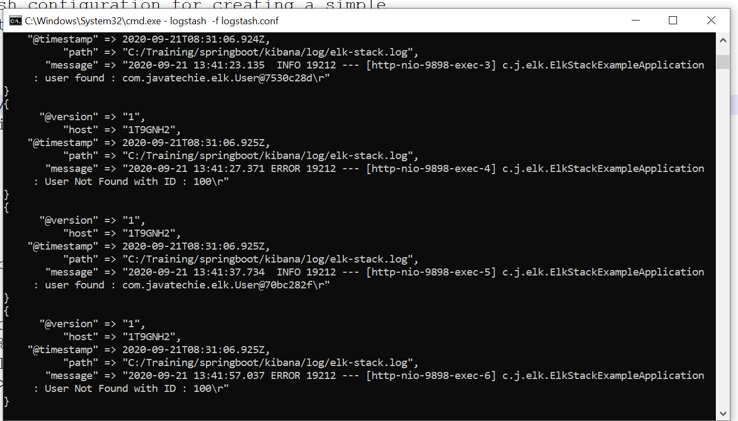
Spring boot - ELK

Slide 45
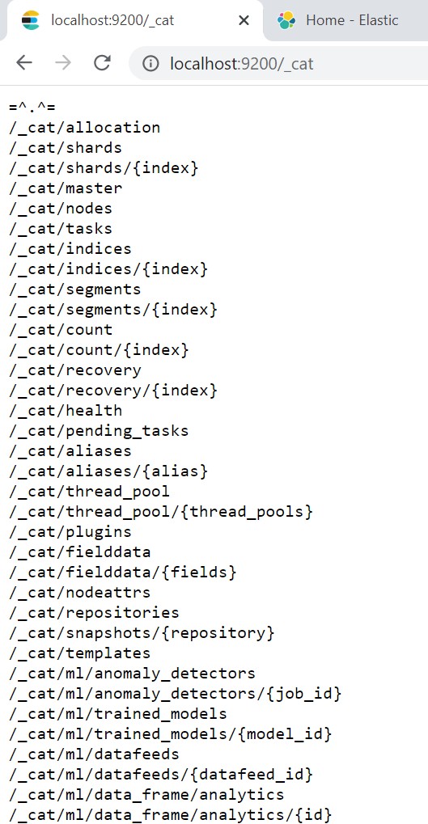
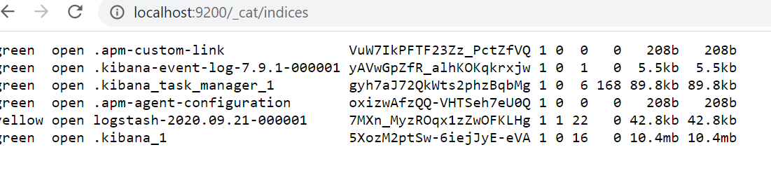
Spring boot - ELK

Slide 46
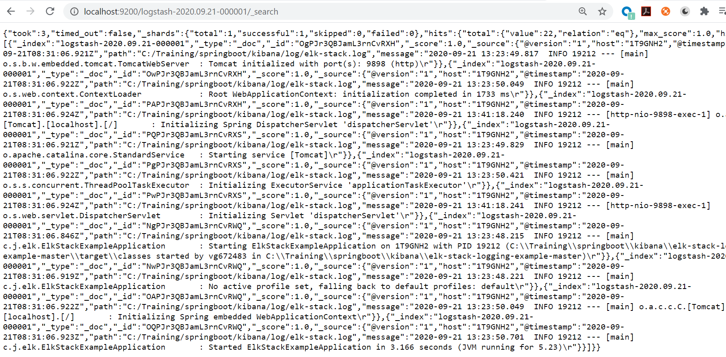
Spring boot - ELK

Slide 47
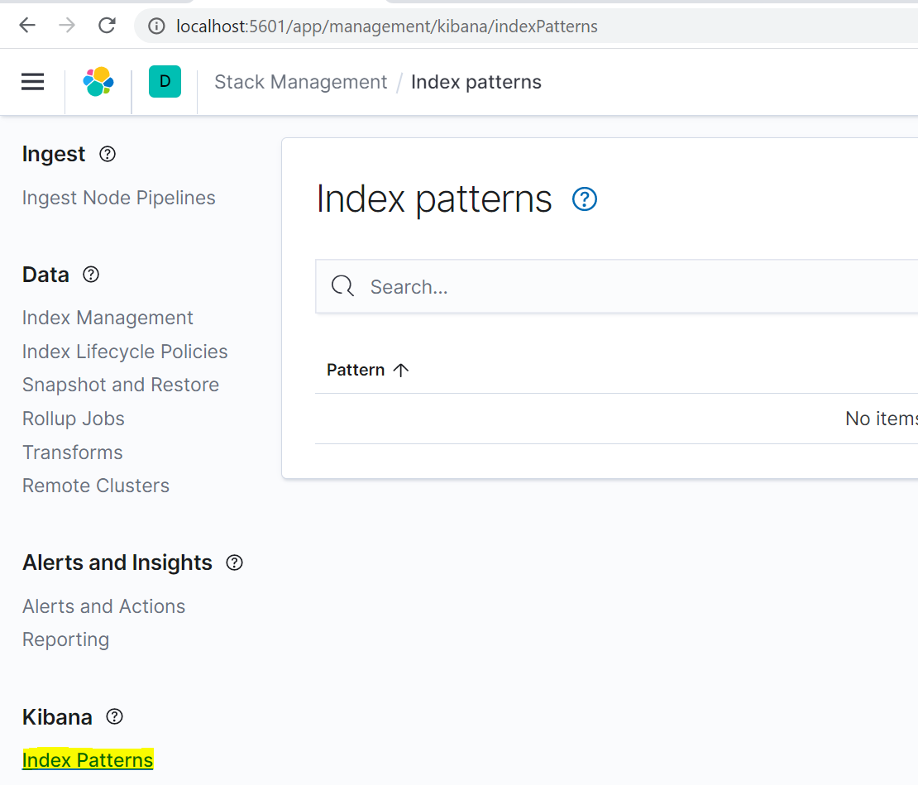
Spring boot - ELK

Slide 48
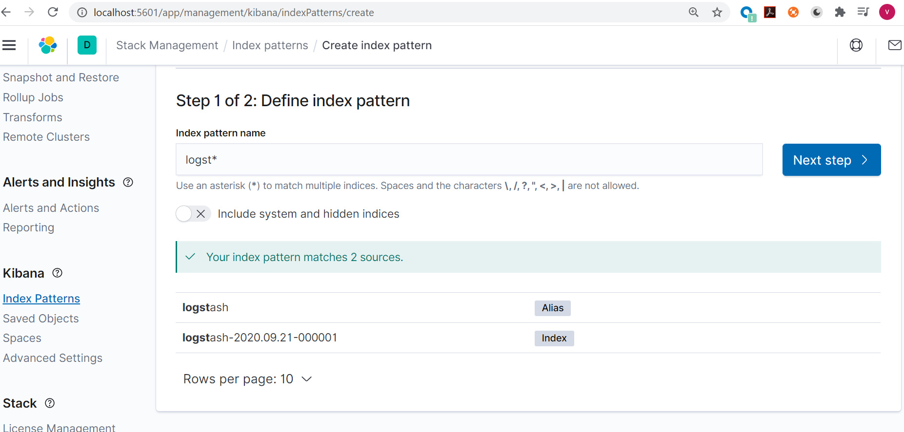
Spring boot - ELK

Slide 49
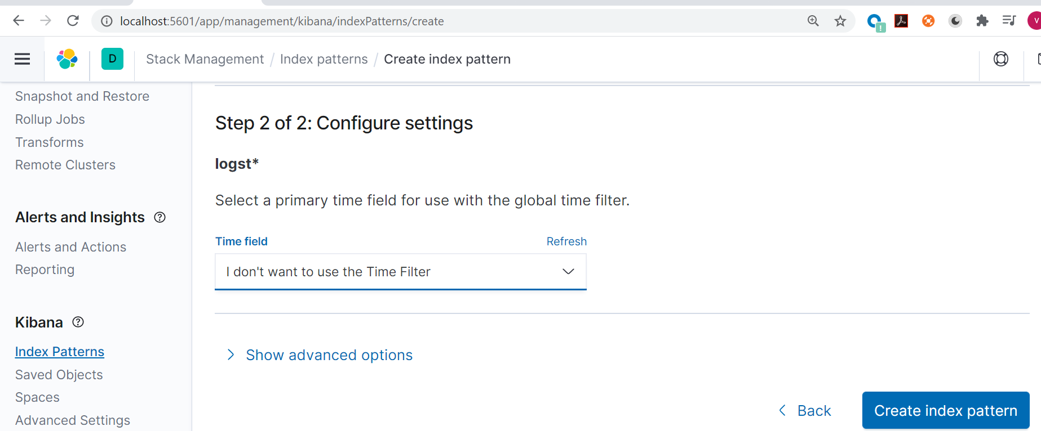
Spring boot - ELK

Slide 50
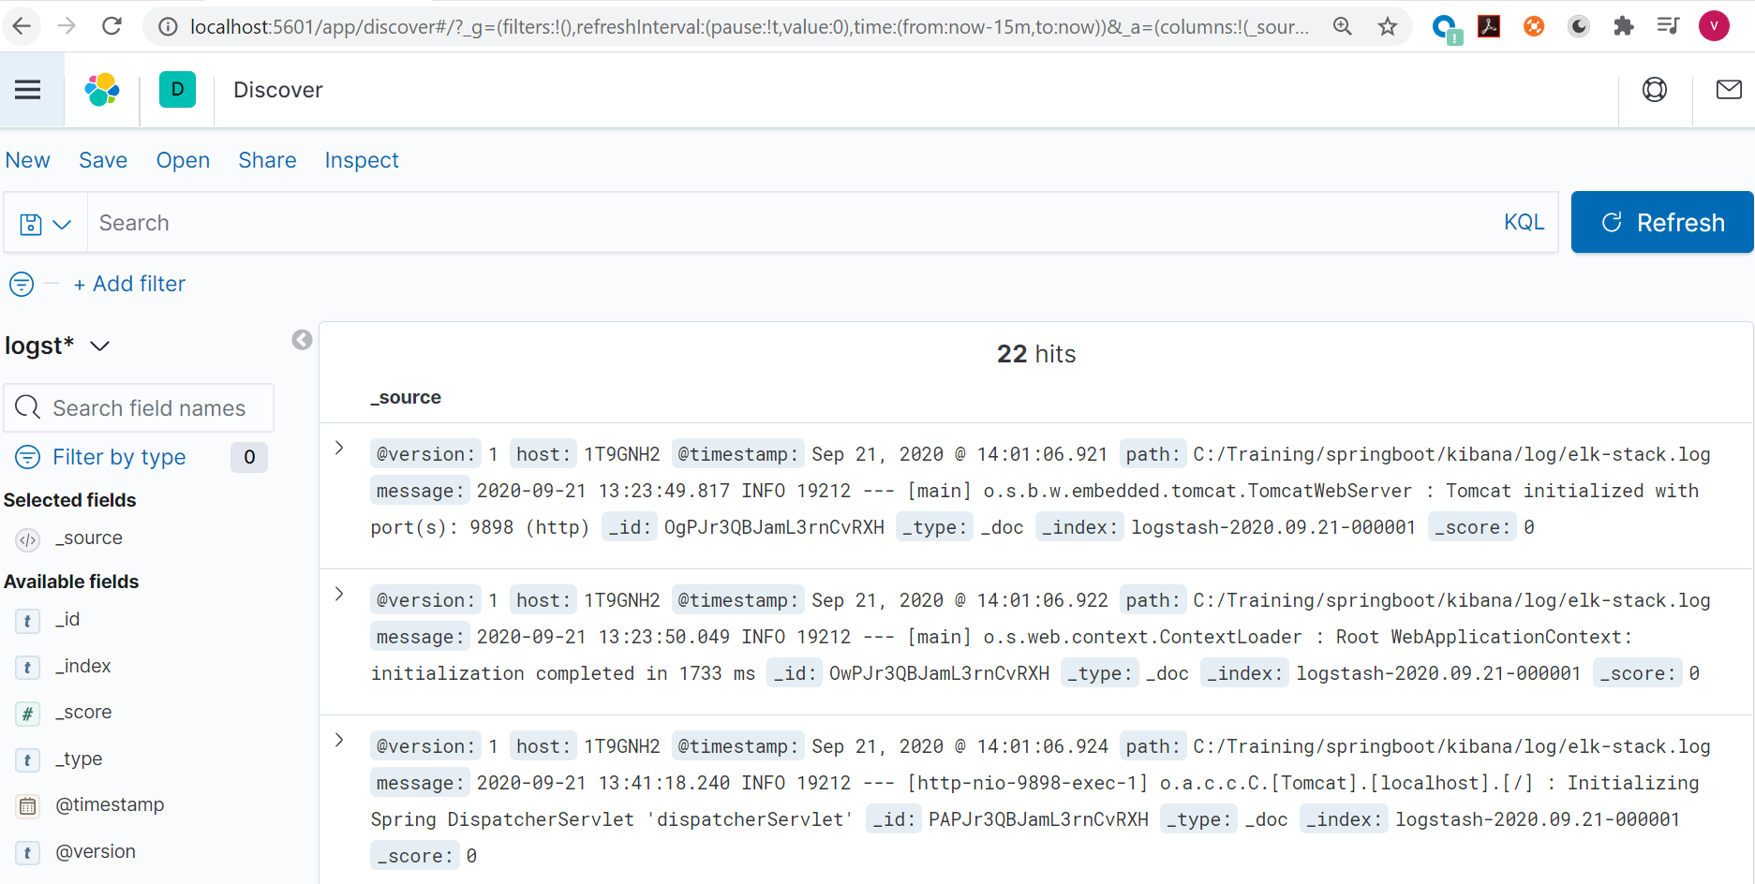
Spring boot - ELK

Slide 51
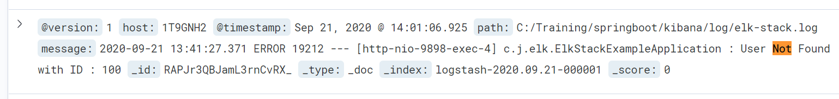
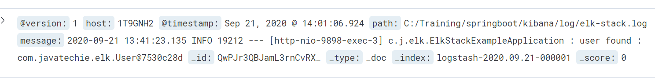
Spring boot - ELK

Slide 52


Slide 53
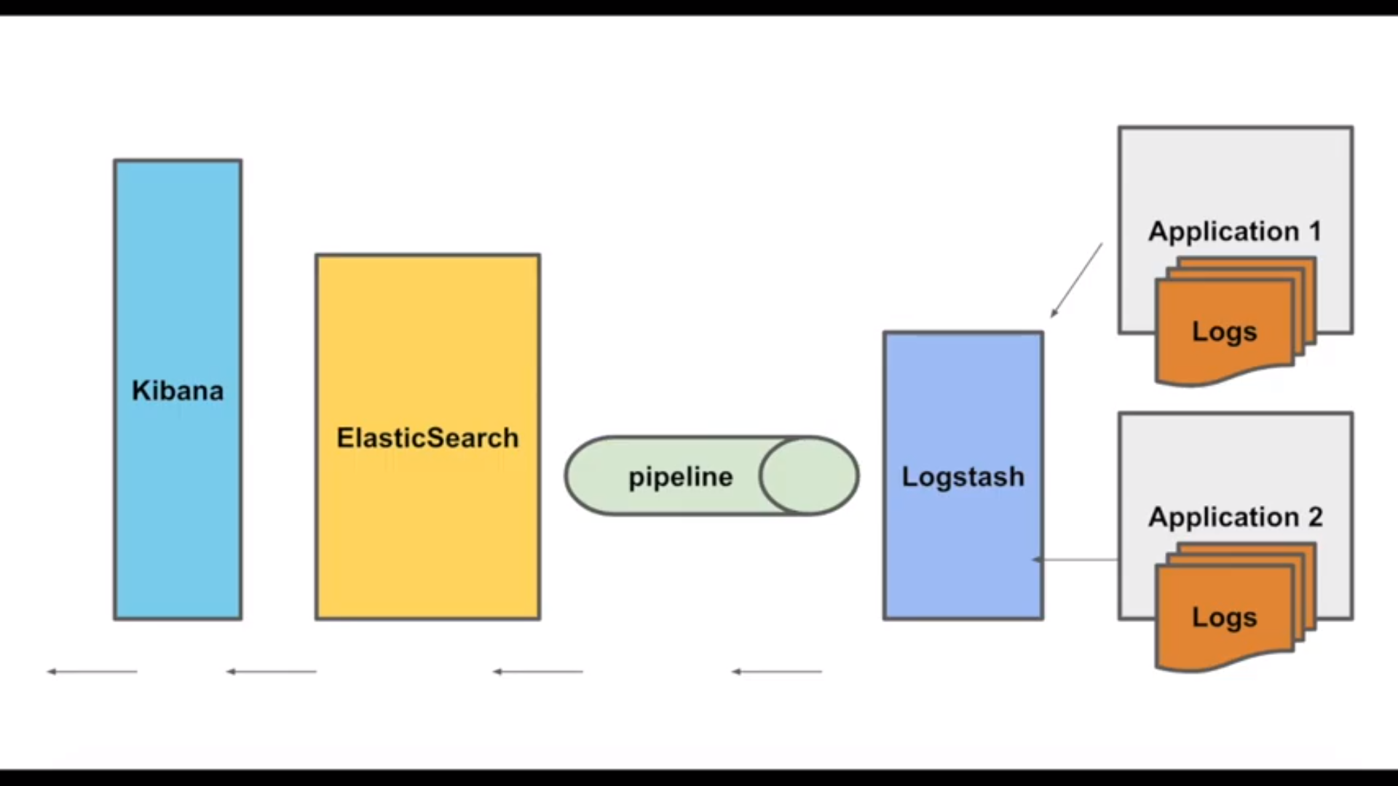
Spring boot - ELK

